Slide 1
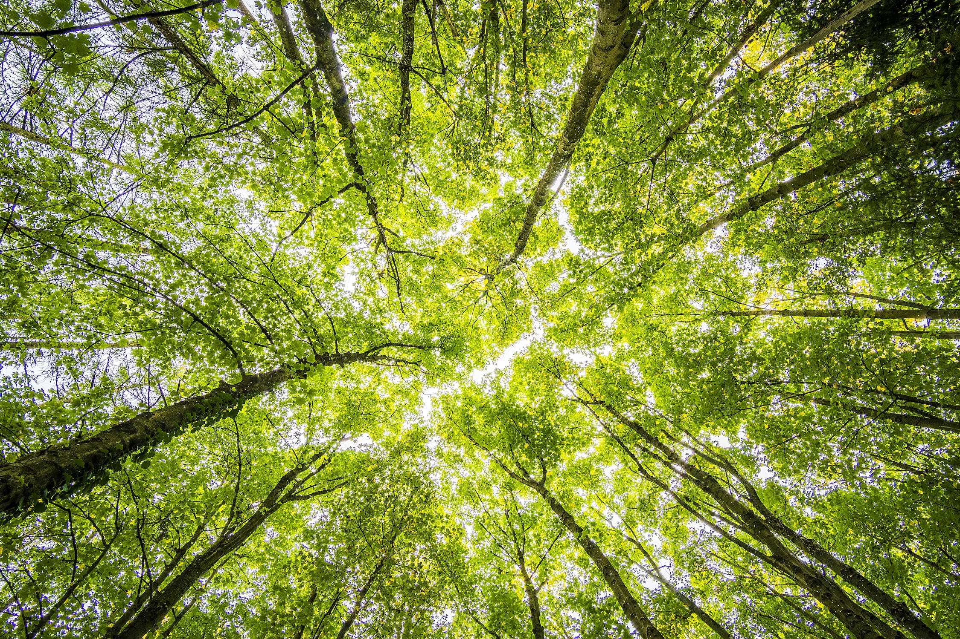

a more Sustainable,
Low-Carbon world
with

Slide 2
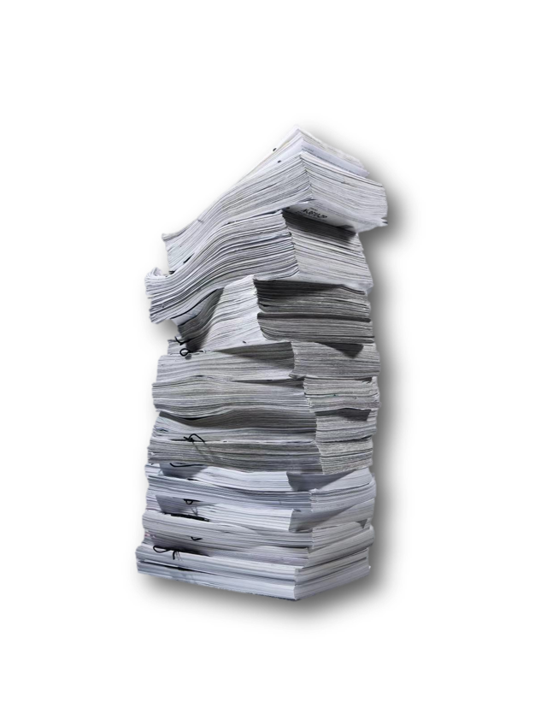
Scenario: 1 Loft, 750 Equipments
1 Equipment: 100 (Initial papers)
+ 360 (Added papers) +2 (RoTE)
= 462 (papers/year)
750 x 462 = 346,500 (papers/year)
Notes:
paper consumed annually

Slide 3
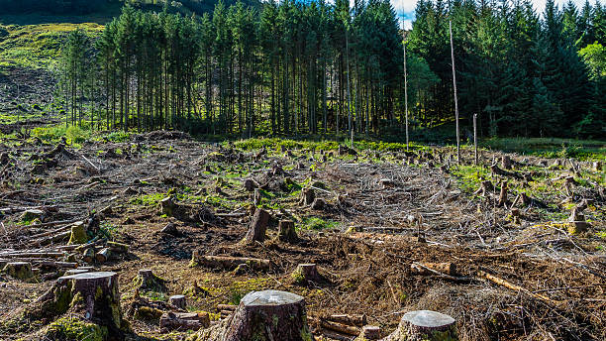
Producing 1 Tone of papers (1,000 kg)
≈ 229,000 (piece of A4 papers)
≈ 24 (trees)
1 Loft: (346,500 / 229,000) x 24
= 36 (trees/year)
Notes:
Amount of paper used and trees per year
Reference: https://8billiontrees.com/trees/how-many-trees-are-cut-down-each-year-for-paper/

Slide 4

1 tree: 12 kg CO₂ (year)
12 x 36(trees) = 432 kg CO₂
1 piece of A4 papers: 18 g CO₂
18 x 364,500(papers/year) = 6,561,000 g CO₂
6,561,000/1000 = 6,561 kg CO₂
1 Loft: 6,561 + 432 = 6,993 kg CO₂ / year
Notes:
A single tree can absorb CO2 at a rate of 12kg per year. (Reference: https://fairsnape.com/2018/07/24/planting-trees-to-offset-construction-carbons/)
On average, emissions are about 17–18 kg per tonne of paper/18 g per paper. (Reference: https://www.holmen.com/en/paper/sustainability/sustainability-stories/how-to-undrestand-carbon-footprints/)
The total of the above two is the carbon emissions caused by using traditional methods.
If they use RiConnect, it becomes the carbon emissions we can help reduce.

Slide 5
RiConnect Digital Technology
As is |  | with RiConnect
- € 2100 | Paperwork | + € 2100
- € 175,000 | Labor | + € 175,000
989.1 kg - € 49.5 | CO₂ | 989.1 kg + € 49.5
x | Data Transmission | 157.5 g (CO₂)
Save € 177,000
Reduce CO₂
Notes:
a. Paper cost savings = €2,100 (210,000 pages times €0.01 per page).
b. Labor cost savings = €175,000 (210,000 pages times 5 minutes per page divided by 60 times €20 per hour).
c. Carbon emissions reduction = (210,000 divided by 200,000) times 942 kg CO2 = 989.1 kg CO2 equivalent.
d. Financial benefit of CO2 reduction = (989.1 kg CO2 equivalent divided by 1,000) times €50 = €49.455.
e. Carbon emissions from digital data transfer = 157.5 grams CO2 equivalent.

Slide 6


