Slide 1
Notes:
So, now, let me introduce the Riconnect Software. Riconnect –connect to safety.

Slide 2
Notes:
From this pictures, what do you see guys? Here, we can see an engineer who probably is going to do a pre-use checks, maintenance or maybe periodic inspection of the equipment.
He is still using a traditional way of using paper and pen to perform the tasks that I mentioned just now.
Can you imagine, for each task, how many papers he is going to use, and it might cause a lots of papers which will be hard to manage and analyze.
These are the pain points that we are currently facing on using traditional way to do pre-use check, inspection, and maintenance.
Have you ever experienced the challenge of locating necessary documentation and confirming the status of equipment among a large number of assets in a facility? It can be a time-consuming task, right?
Back in the day, it always paper work when it comes to documentation management of equipment. But now we have digitalized the list from paper based to RiConnect.

Slide 3
As is
10,000 equipment:
10,000 x 1 hour
= 10,000 hours
= 1,250 days
= 4.5 years
Notes:
When we introduce this to one of our customer, they have told us that, it really helps them as they are currently having about 10 thousand equipment in 3 different facilities.
and when the documents are needed for audit, can you imagine how much time you will spend finding out the documents for each piece of equipment?
An hour for each piece of equipment means you will need to spend about 10 thousand hours, which equals to 4.5 years. Obviously, this is not an efficient way to produce good value in a company.
Given the current circumstances, managing a total of 10,000 equipment pieces would require a significant amount of time. If it takes an average of one hour to locate information for each piece, it would amount to approximately 1,250 working days to effectively manage the entire workplace.

Slide 4
Status of Equipments
Equipment Traceability
Notes:
In RiConnect In RiConnect, we only focus on : status of equipment and documents of equipment.

Slide 5
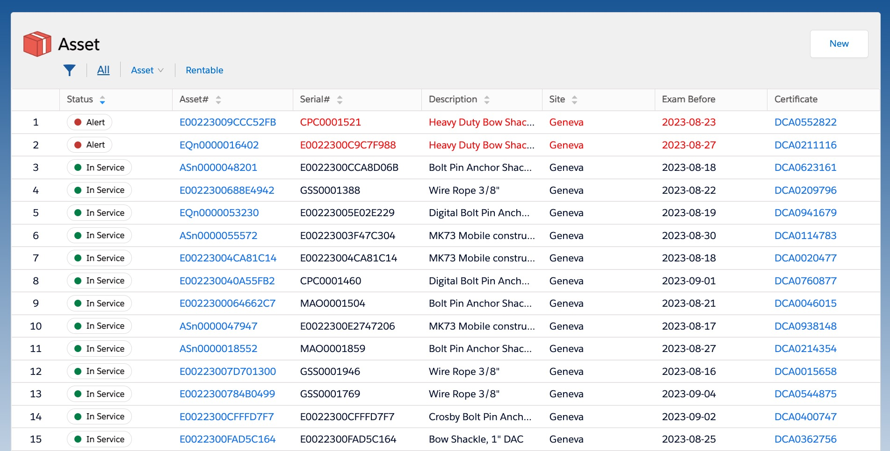
Notes:
On this slide, you can see the screenshot of Asset Module on Riconnect website .
At this page, you will be able to get the real time status of your assets * whether it is in alert or in service; the latest examination date*; the certificate number*, the serial number, description and even the location of your asset.
RiConnect streamlines the process of identifying equipment in need of attention within your company by offering a clear overview of their status.
With RiConnect, you can quickly access crucial details like equipment status, upcoming inspection dates, and relevant certificates, all in one user-friendly system.
The equipment owner can see the status of each equipment when the equipment needs to be examined and the certificate.
Let’s take this Bolt pin anchor shackle for example.

Slide 6
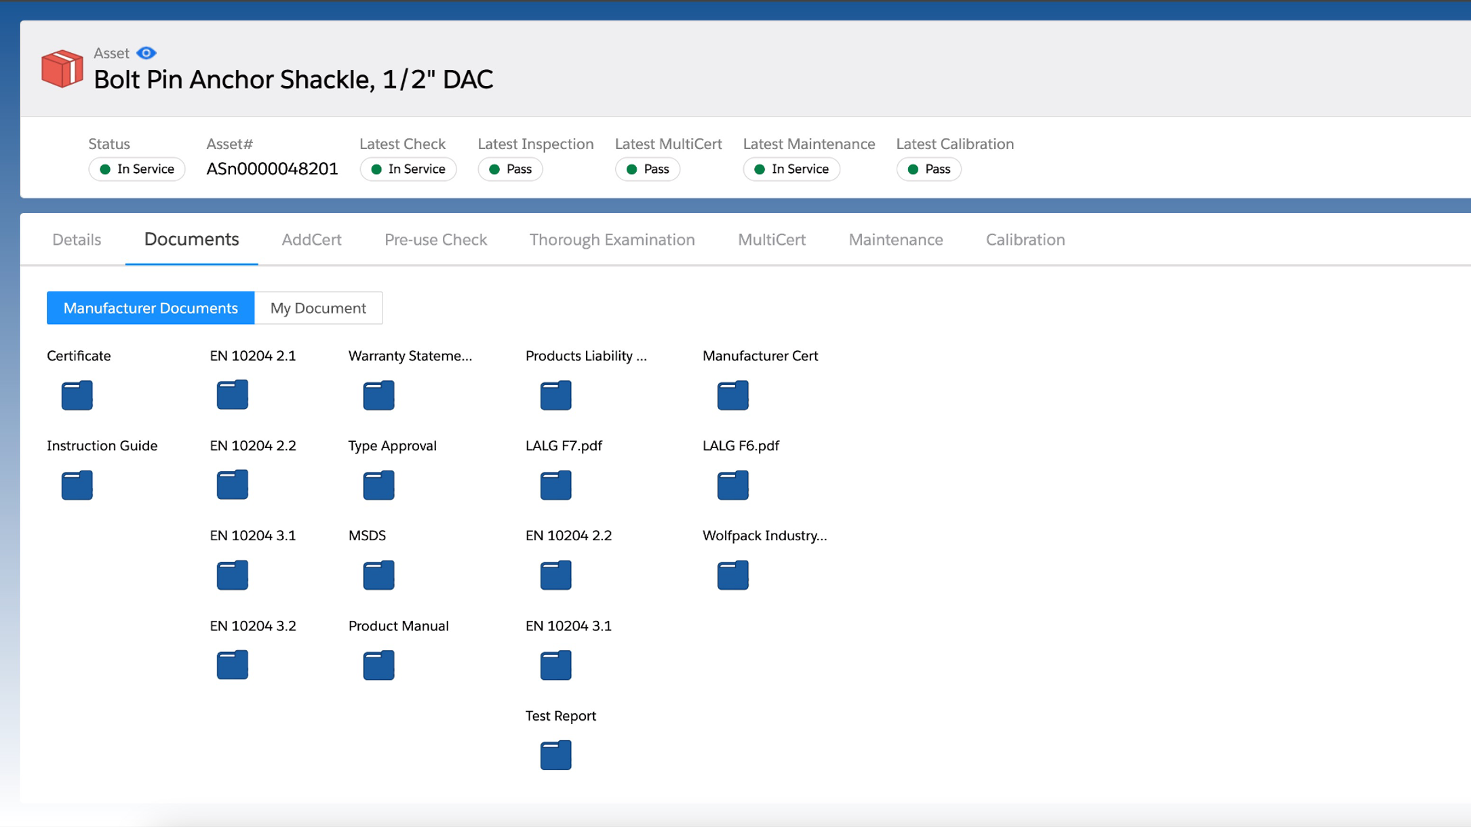
Notes:
ok, let’s move to the next slide.
As an asset owner, you will be able to retrieve all the manufacturer’s documents here.
From certificate, instruction guide, warranty statement, and even product photo, you named it.

Slide 7
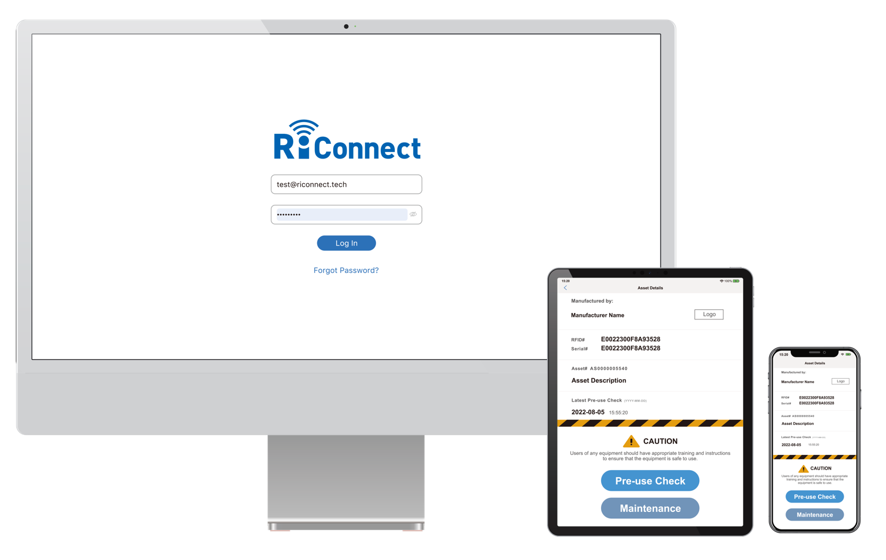
Notes:
And, Riconnect is accessible by laptop, tablets, and mobile phone.
It also supports over 46 languages and off-line function which is really helpful in some remote area.
RiConnect支援手機、平板及電腦。
只要有網路，就可以連接上RiConnect
但是呢，沒有網路我們一樣支援設備離線管理
RiConnect同時支援46國語言及世界各國的規範包含英國的LOLER,日本的 JISHA, 美國的 OSHA及ASME

Slide 8
Information follows the product.
Once you own an asset, you own the information.
—— Core Value of RiConnect
Notes:
In the past, all products information are scattered everywhere.
It could be kept separately at the inspection company’s, manufacturer, or even distributors.
But in RiConnect’s, information follows the product, so once you own an asset, you own the information.
At RiConnect, we firmly believe in the principle of "information follows the product." This means that when you own an equipment, you also own its information. Let’s dive into this concept further... (Continued on next page)

Slide 9
Stakeholders
Manufacturer
Field Personnel
Equipment
Owner
Auditor/
Surveyor
Inspection
Company
Notes:
To elaborate more, there’s different stakeholder on RiConnect.
Let’s assume that manufacturer has attached the RFID tag on the products. As the manufacturer we will provide a certificate and any related documents to the asset owner.
Once the products was sold to asset owner.* It becomes an asset to the owner. The asset owner gets the chance to view all the product information coming directly from the manufacturer.
The asset owner can have field personnel to perform pre-use check, maintenance and inspection. If the field personnel do the checks, the result of the check will be captured on RiConnect. The latest status and location will be available as well.
Sometimes, periodically, asset owner will need to get 3rd party inspection company to perform another witness test by bureau. They can upload the certificates or reports back on RiConnet so the asset owner gets to know which asset is about to due and need thorough examination.
We also have auditor and surveyor roles so they can download the Riconnect App. When they sign in as guest on App, they get to review the product information or equipment information but only under the manufacturer or equipment owner’s authority.
So, can you see how it relate here?? If 1 document is missing, then they will not be able to identify the complete product information.
RiConnect enables smooth information sharing among stakeholders in the supply chain, such as product manufacturers, equipment owners, field workers, and inspection providers.
It includes an efficient equipment management system and seamless communication features.

Slide 10
Inspection
Manufacture
Rental
Equipment
API
Connector
Supervision
App
Notes:
Different stakeholders means we have different module including manufacturer, inspection, rental.
For supervision module, the equipment owner can share their information to whoever they want to share.
And Riconnect App, the front-line operator can simply perform the pre-use check with their mobile phone.
Api connector, the API key can be connected with ERP system or whatever system you have.
RiConnect focuses on the Equipment module, which is the core component. It also includes other modules like Manufacture, Inspection, Rental, and Supervision. A mobile app is available for easy access. Moreover, RiConnect provides an API Connector for smooth integration with clients' existing systems.

Slide 11
Identification
or
Serial Number
Certificate
of
Calibration
Declaration
of
Conformity
Maintenance
Record
Equipment
Traceability
Manufacture
Documents
Multiple
Certificates
Distributor
Additional
Certificate
Report
of
Thorough
Examination
Pre-use
Checks
Notes:
Conclude about Riconnect, is to provide equipment traceability based on Identification or serial number; DOC; manufacture documents, distributor additional certificate, pre-use check, report of thorough examination, maintenance record, and certificate of calibration.
So, in the product lifecycle, Riconnect can provide you with the equipment traceability based on the doc. mentioned above.
RiConnect's powerful core feature, Equipment Traceability, makes all of this possible. It allows you to easily manage important information related to your equipment, such as Serial Number Identification, Declaration of Conformity, manufacturer documentation, additional certificates from distributors, Pre-use Check records, Report of Thorough Examination reports, daily maintenance records, and calibration reports.

Slide 12
Notes:
Ok, let me show you the asset list on website here.

Slide 13
Notes:
When you click on the asset no., we can see the details of this equipment like…

Slide 14
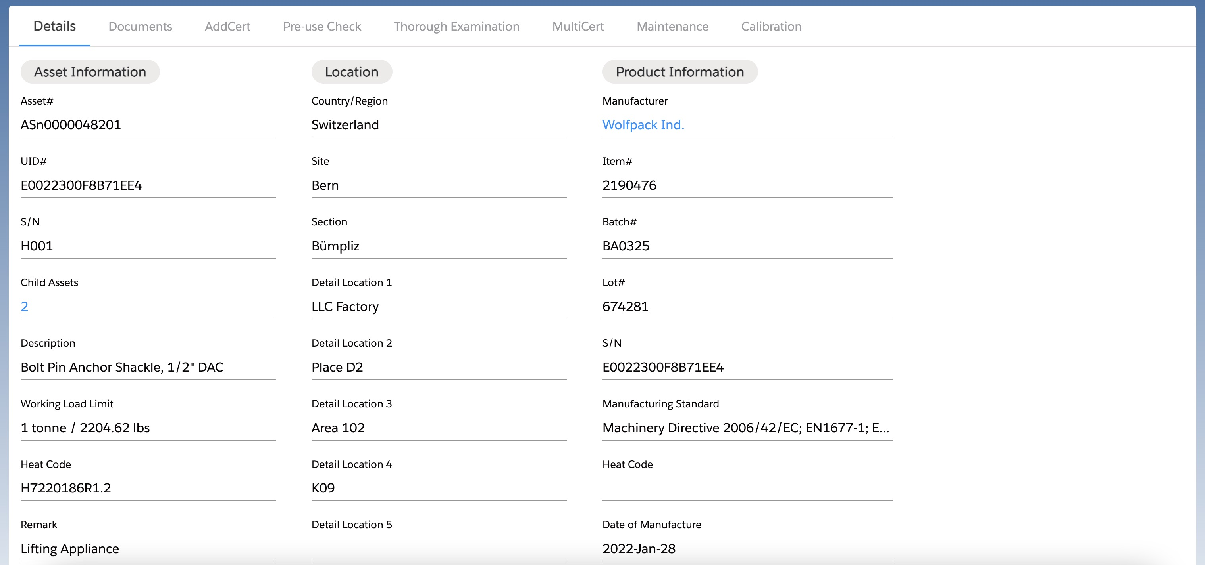
Notes:
You'll have a complete and organized view of all the relevant information associated with that equipment, making it easy to access and refer to.
If the manufacturer is on RiConnect, the product information* will come along directly from manufacturer.
For the location in the middle side, it’s the fixed location.
For the geolocation part will be put under pre-use check and maintenance.
When the operators perform the pre-use check or maintenance, the geo location will be captured for record.

Slide 15
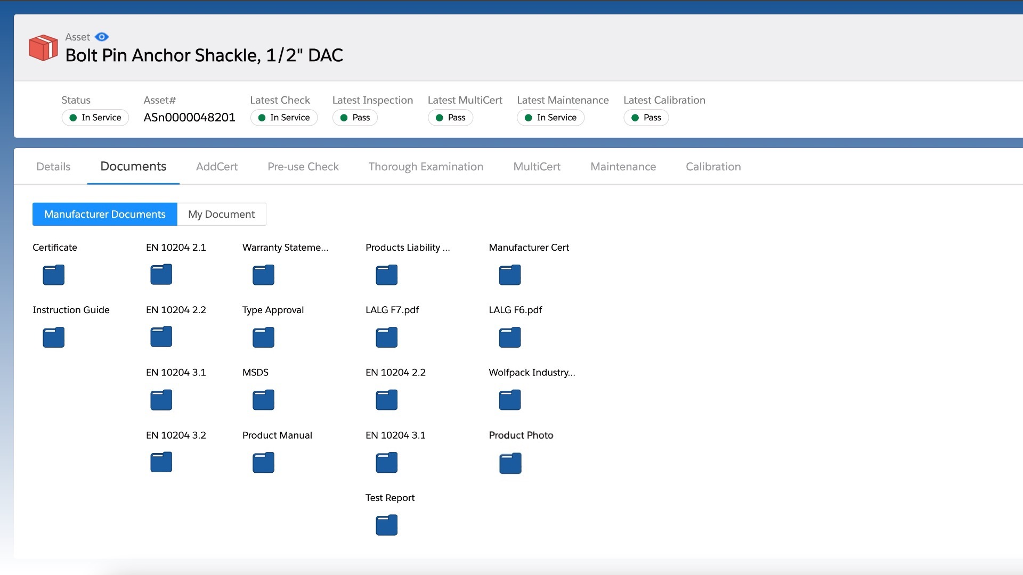
Notes:
Here’s the documents which used to be paper-based documentation and very easy to get lost.
Now with digital solution they came along from manufactures directly.
With just a click on a document, you can access to any documents you want.
a repository of manufacturer-provided documents and easily manage your own previously paper-based documentation. This streamlined approach greatly enhances operational efficiency.

Slide 16
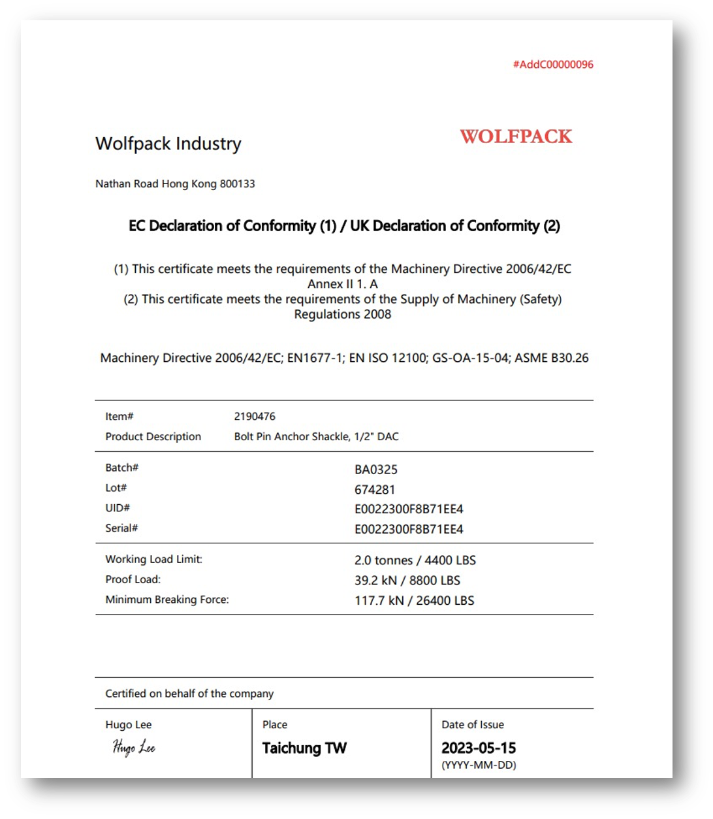
Notes:
When you click on a certificate, you'll immediately see all the relevant information related to that specific equipment.

Slide 17
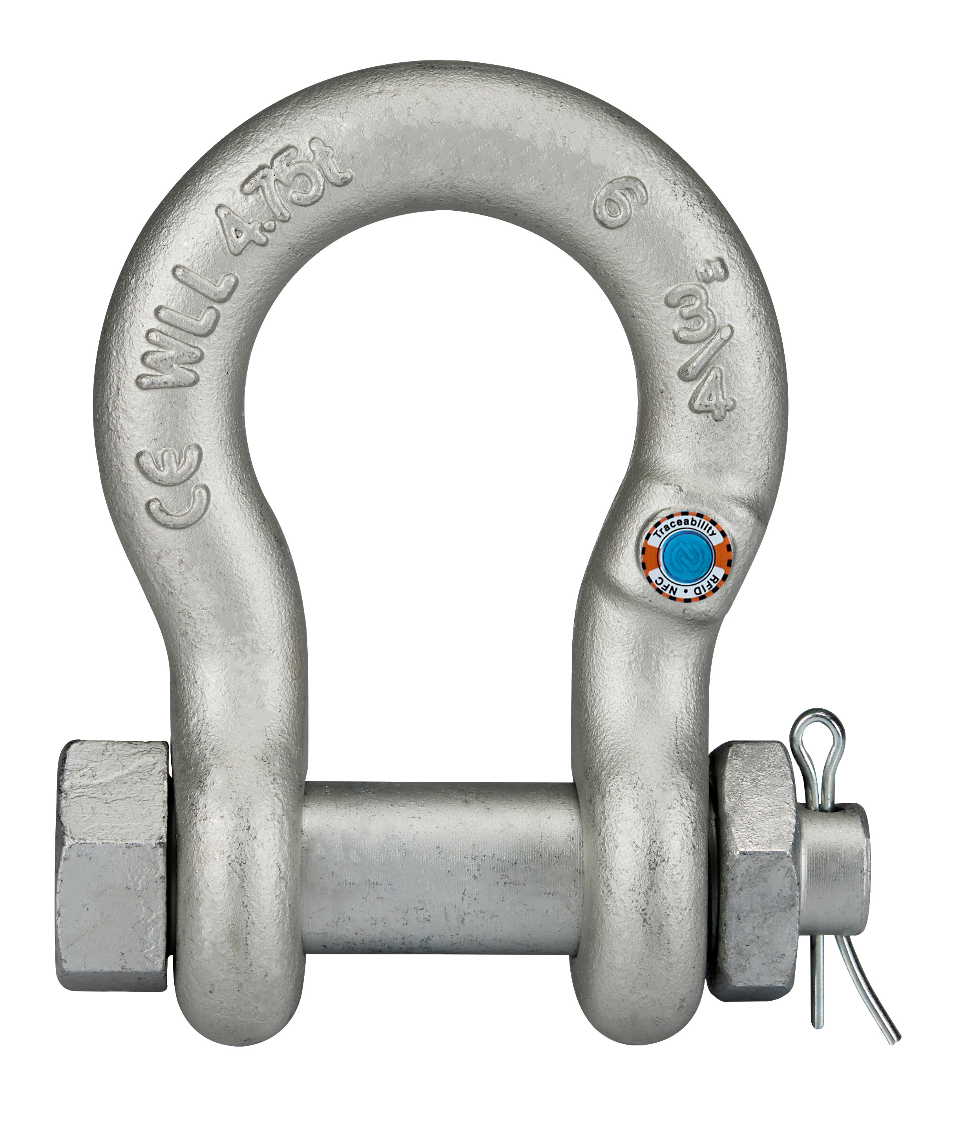
Notes:
Additionally, you can also view images of the equipment.

Slide 18
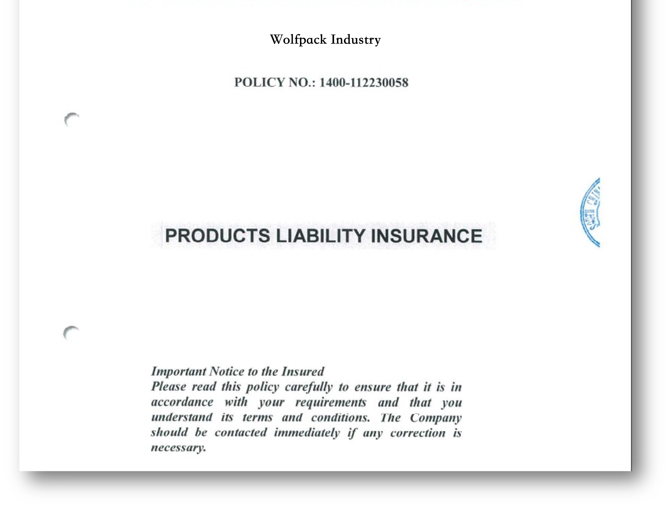
Notes:
The equipment owner also can upload and manage your own documents, like product insurance etc.

Slide 19
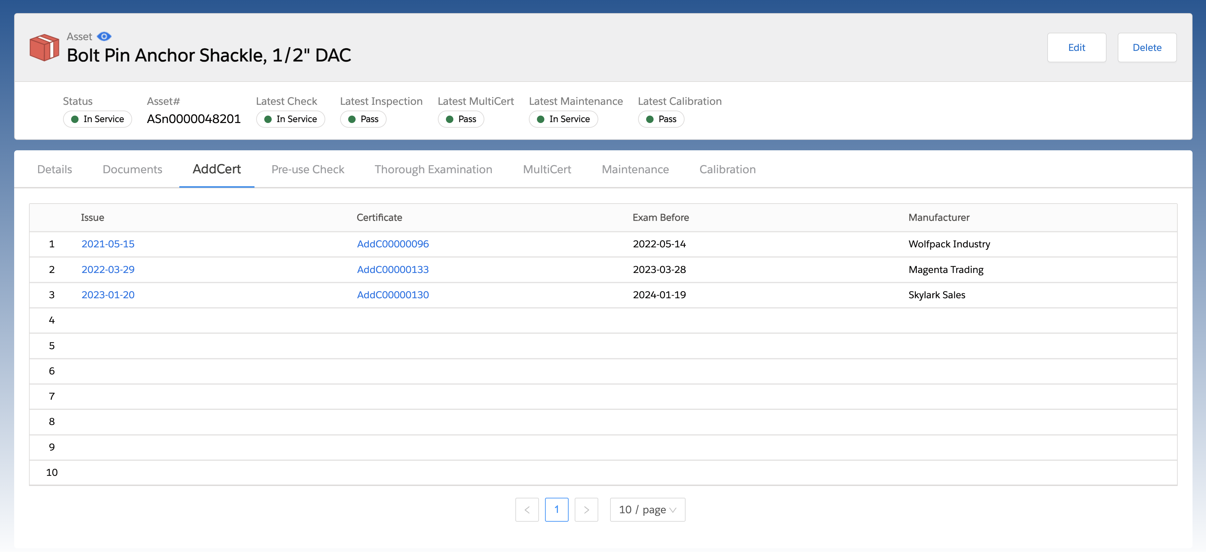
Role:
MFG: Manufacturer
A: Distributor
B, C, D, E: Distributor
Asset Owner
MFG
A
B
Asset Owner
Notes:
When you click on "AddCert," you can easily obtain any additional certificates provided by the distributors.
For addcert founction, it means additional certificate.
In lifing industry, when the manufacturer sale the products to customers, sometimes there’re distributors in the middle to distribute the products to end users. The distrbuters can use this addcert function to generate the certificate based on different situation. All the certificates will be displyed under the addcert tab.
The end user will get to know which certificate came from which distributors.
Supplementary (Sometimes in oil & gas industry, some equipment such as oil or waterflow equipment will need to do a periodical calibration or recertification.
On this addcerts feature, it allows distributors or inspection company to add an additional document or certification when some certain test is conducted on this equipment in between the process. )

Slide 20
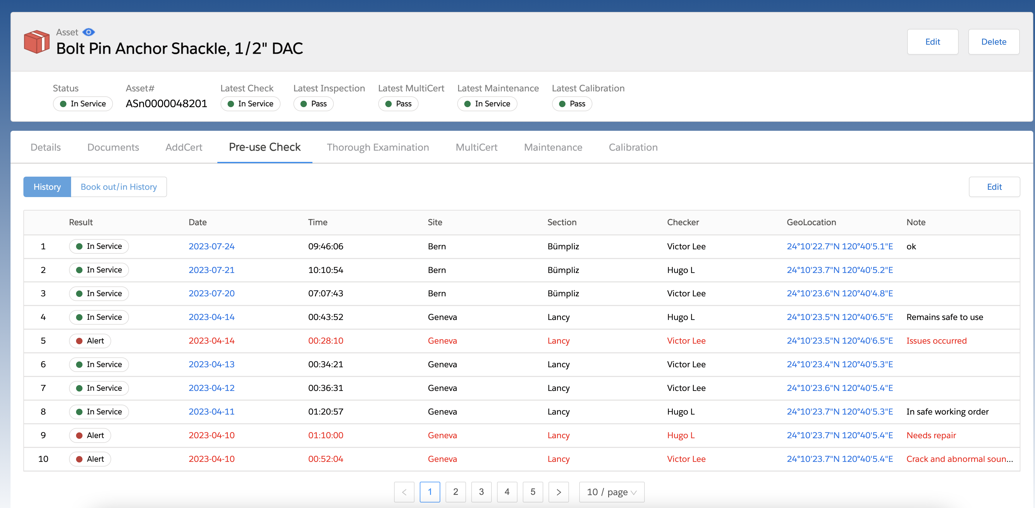
Notes:
At this pre-use check feature, you can see the record / history of pre-use check of the asset.
For an example * On 14th April 2023, Victor has conducted a pre-use check and he found a crack and abnormal sound of the asset.
So, on the same date 14th April, his manager Hugo made another pre-use check again and make a note that it will be need for a repair.
After the repair is conducted,* on 14th April, Hugo do another pre-use check and the result of the pre-use check is in safe working and equipment is ready to be use.
The geolocation is also captured when doing the pre-use check so when you click on the geolocation.
It will redirect you to Google map.

Slide 21
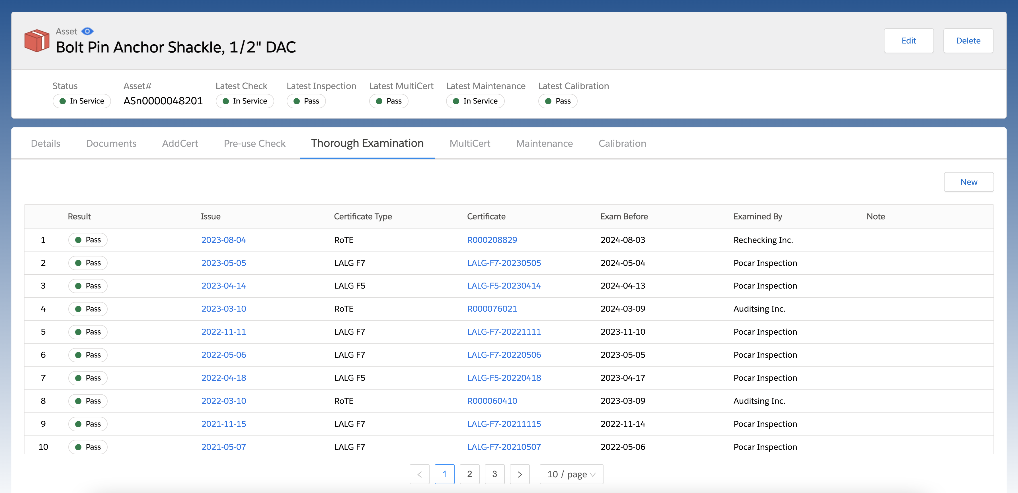
Notes:
According to the regulation, the certificate will need to be renewed after certain period of time which is different from region to region.
Under this thorough examination tab, you can see the complete thorough examination history that has been conducted on the asset.
With the Thorough Examination feature, you can manage all inspection certificates and documents efficiently. Moreover, you can easily identify if any inspections are nearing their expiration dates.
With the Thorough Examination feature, the equipment owner can upload the certificate or report under this tab, so you get to see the the type of the report and due date and examined by which company.

Slide 22
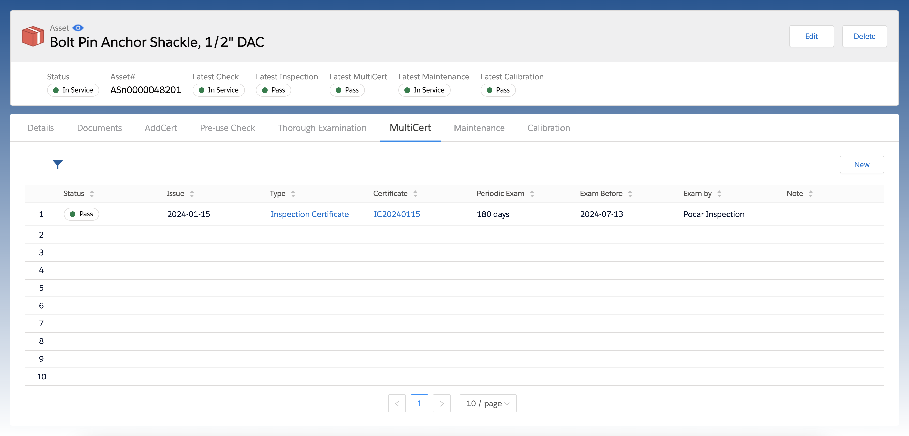

Slide 23
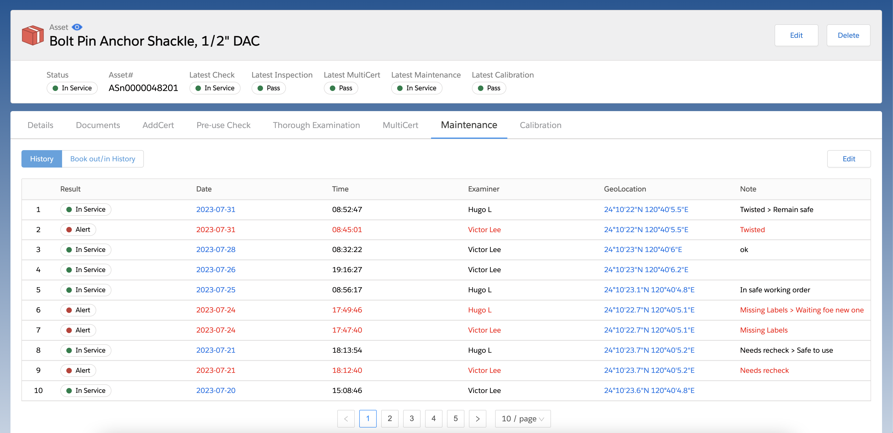
Notes:
Under Maintenance tab, you can view all the records of periodical checklists.
The main different between pre-use check and maintenance is for pre-use check is required to be done whenever prior the operation.
For maintenance, we need to setup a period like every 30 days that we want to perform the maintenance like lubrication.
Same on the maintenance feature here.
If you see the record, on 31^{at} July 2023, there was a crash on the asset.
After the maintenance has been conducted on the same date, the asset is in service and ready to be use.
You will be able to track the maintenance history record conducted on the asset.
And you will also be able to see who the personnel conducting the examination of the asset.

Slide 24
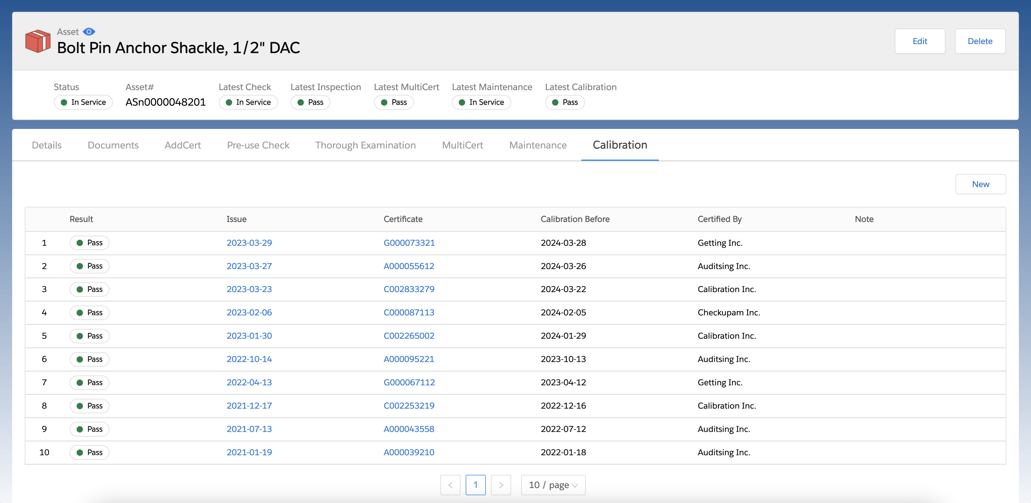
Notes:
And the last feature, Calibration.
You will be able to see the calibration history here, who was the company that conducting the calibration test on the equipment.
When is the next calibration date?
You can easily upload and manage calibration reports for the equipment within RiConnect.

Slide 25
Identification
or
Serial Number
Certificate
of
Calibration
Declaration
of
Conformity
Maintenance
Record
Equipment
Traceability
Manufacture
Documents
Multiple
Certificates
Distributor
Additional
Certificate
Report
of
Thorough
Examination
Pre-use
Checks
Notes:
This is the core highlight of RiConnect: Equipment Traceability, ensuring safety as a top priority in your operations.
To summarized, starting form serial no. the equipment no. has their unique no. which can be tracked down.
The DoC and manufacturer documents can come along with this product from manufacturer to distributors.
All types of inspections including pre-use check, report of thorough examination and calibration we provide to equipment owner

Slide 30
Notes:
Together, let us strive to achieve the motto "Safety is Essential" and create a safer working environment for all.

Slide 31
How to get started
Create a company account on RiConnect..
Set up a free demo or training date with us.
Start applying digital solution to your assets or products.
Register as RiConnect Partner
Implement User Registration (landing page) on website, social media etc.
1
2
3
4
5
Notes:
1. As we hope that all of our partners get familiar with our digital solution before actually promoting them, it’s important to have a hands-on experience on it.
2. During the training session, your team will know more detailed functions of the software.
3. As mentioned, it’s important to have a hands-on experience so it would be better if you can physically apply it into your daily business.
4. Once Register as RiConnect Partner, you’ll receive an email with a link which is a landing page which you can share with your customers or put it on your website.
5. The traffic and profit is calculated based on the users who is registered through the link.

